Slide 1
Bennett Orthopedics bennettorthopedics.com
Knee Rehabilitation Exercises

Slide 2
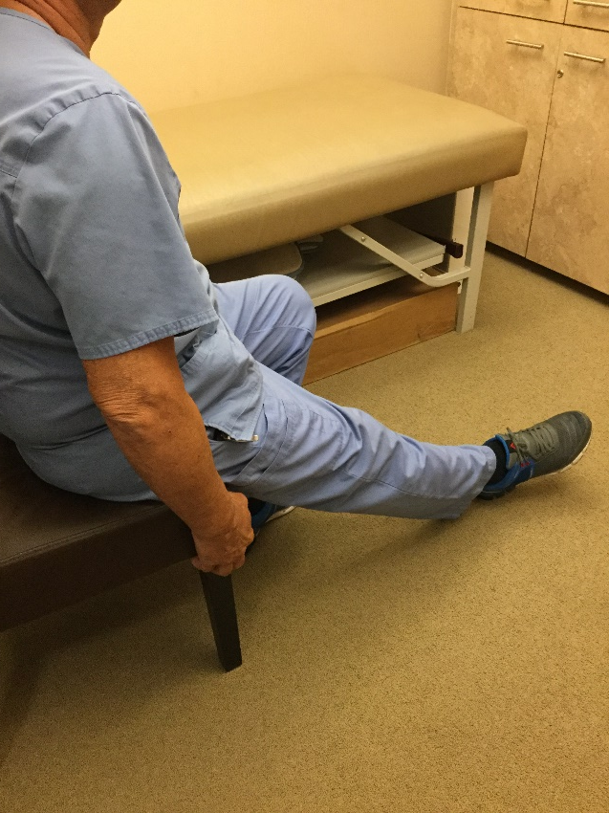
PatellaR Mobilizations
Start in this position
Best when done in a seated position with leg fully extended
Sit towards the edge of the chair with heal on the floor, foot pointed outward
Find the ridge on both sides of your patella
Gently push to one side and hold for 30 seconds
Push to the right, left, up, down, clockwise and counter clockwise
15 min 3xday

Slide 3
Quad Sets
With leg fully extended
Place a small towel under heel
Push back of knee against table
Hold for 5 seconds then relax
You should be able to see the muscles in the thigh tighten.

Slide 4
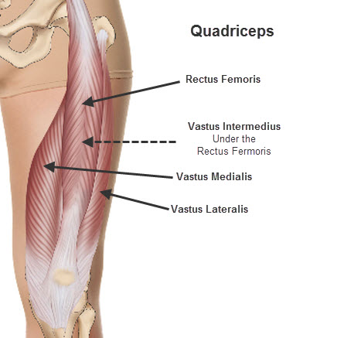
Straight leg raises Flexion
Keep opposite knee bent
Tighten thigh like you would do in a quad set
Keeping leg straight, lift so it’s even with the other knee
Hold for 5 seconds
Complete 10x
Muscles being used

Slide 5
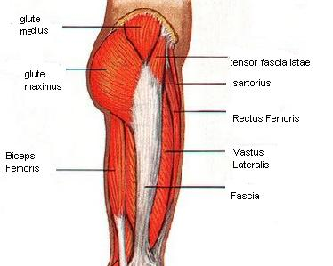
Straight Leg Raise Abduction
Lay on the opposite side of the knee that hurts
Keep leg straight and lift leg
Don’t lift so high that your hip turns out
Hold for 5 seconds
Complete 10x
Muscles being used

Slide 6
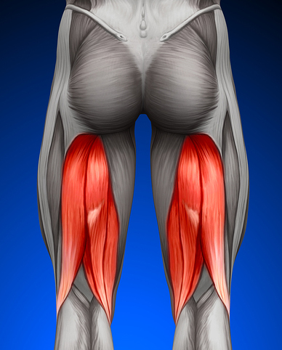
Straight leg raise extension
Muscles being used
Lie on your stomach
Keeping your leg straight, extend your leg in the air
Hold for 5 seconds
Complete 10x

Slide 7
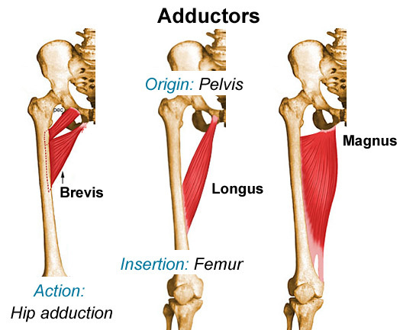
Straight leg raise adduction
Lie on the side that is being treated
Uninjured leg is bent and foot is on the table in front of the injured side
Keeping injured leg straight, lift leg off of table
Hold for 5 seconds
Complete 10x
Muscles being used

Slide 8
Short arc quads
Lying on your back
Place a pillow or rolled up towel under your knee
Keeping thigh on the pillow, extend your lower leg
Hold for 5 seconds
Complete 10x

